Slide 1
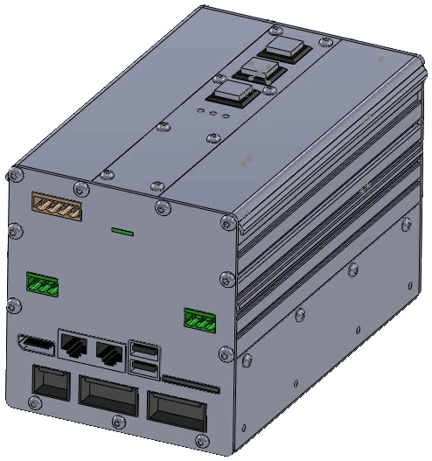
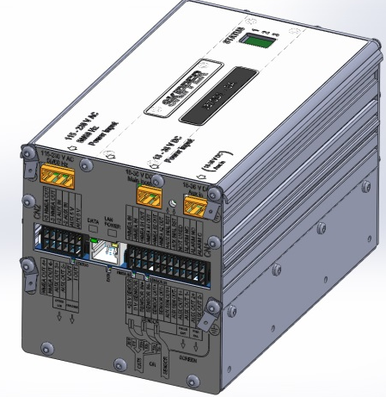
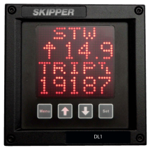
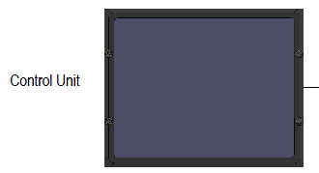
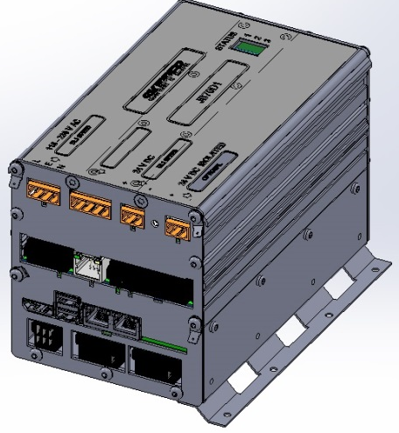
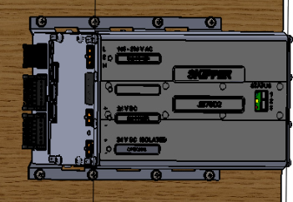
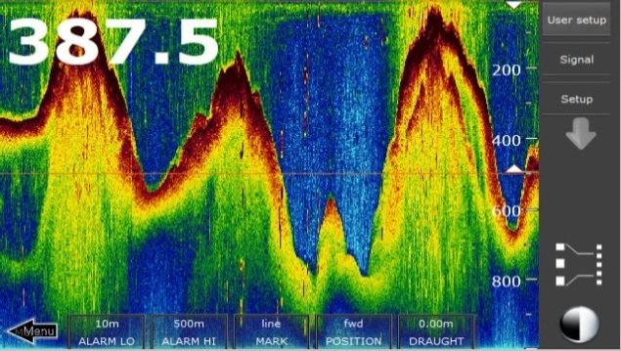
The Multi Series
ES1-Multi
SKIPPER Electronics AS
Enebakkveien 150
0680 Oslo
www.skipper.no
Tlf. +47 23 30 22 70
Fax +47 23 30 22 71
sales@skipper.no
support@skipper.no

Slide 2

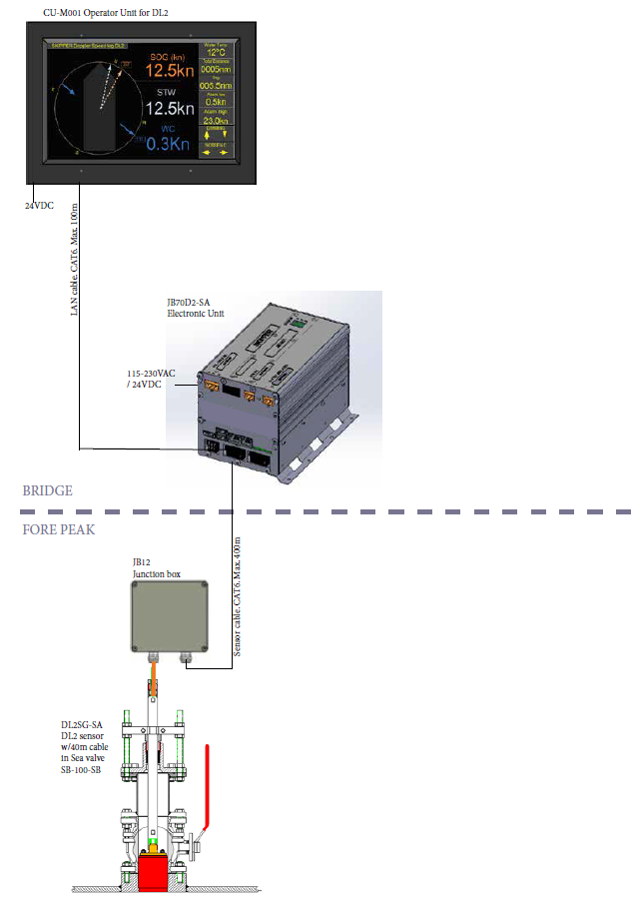
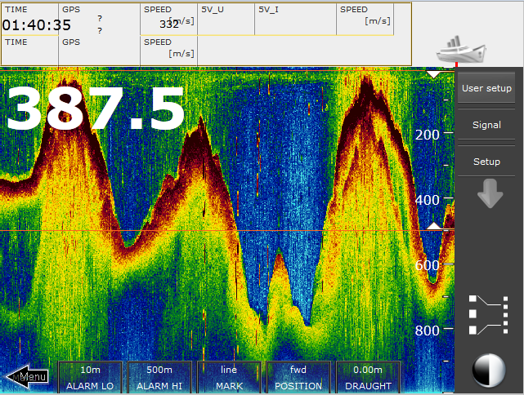

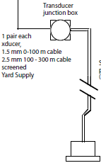


New Echo Sounder
SKIPPER ES1
Launch Q1/Q2 2015
Totally new system consisting of:
  JB70E1 Interconnection unit.
  New 50/200kHz combined transducer
    Compatible with all SKIPPER transducers and most other transducers.
  Touch display unit (optional if INS approved)*
  Full Web interface
SKIPPER Electronics AS
Enebakkveien 150
0680 Oslo
www.skipper.no
Tlf. +47 23 30 22 70
Fax +47 23 30 22 71
sales@skipper.no
support@skipper.no

Slide 3

New Echo Sounder SKIPPER ES1
10-300 kHz
  1 1KW Channel (extendable to 6 simultaneous channels)
Chirp Technology – longer range in same transducer
LAN output
Web interface for setup and/or Display
Can be controlled from IBS or Optional Screen with touch
Wheelmarked
Unlimited memory (memory card dependent)
NMEA and analogue output signals
Alarms
Same transducers/Bottom mounting as GDS101 + new 50/200kHz transducer.
SKIPPER Electronics AS
Enebakkveien 150
0680 Oslo
www.skipper.no
Tlf. +47 23 30 22 70
Fax +47 23 30 22 71
sales@skipper.no
support@skipper.no

